Slide 1






dsa PROJECT
Browser
History
Manager
Class: AI_B
Team members:
Rahul – 24151
Mukesh - 24103
Naveen Nandha – 24119
Monish - 24122

Slide 2




Browser manager
This project aims to develop a robust system that not only records and organizes browsing history but also empowers users with privacy-focused controls and intelligent insights into their web behavior.

Slide 3
What We Involved In this !
🔍 Data Structures Used in the Project
📌 1. Doubly Linked List
Used for managing browser navigation history.
Allows smooth backward and forward movement through visited pages.
Each node holds a web page and links to both previous and next nodes.
📌 2. Stack (Undo/Redo Feature)
Undo Stack stores previously visited pages.
Redo Stack allows re-visiting undone actions.
Mimics text editors' undo-redo functionality.
📌 3. ArrayList (Bookmarks)
Stores bookmarked pages for fast access.
Simple linear structure to maintain a list of favorites
💡 Why These DSAs?
DLL supports bidirectional navigation efficiently.
Stack ensures LIFO-based undo/redo.
ArrayList is fast for iterating bookmarks and displaying them.

Slide 4


What could be the Future Implementations?
Export/Import Feature:
Save and load history/bookmarks from a file (like JSON or CSV).
Real-time URL Preview or Page Loader:
Integrate a browser component (e.g., JEditorPane or embedded browser) to preview websites.
Categorized Bookmarks / Tagging:
Group bookmarks by topic using custom tags or folders.
Sorting & Filtering History:
Sort by date/time, or filter by domain or
keyword.
Enhanced Search with Suggestions:
Autocomplete search with previous results or popular pages.
Dark Mode / Custom Themes:
Improve GUI aesthetics and personalization.
Integration with Web Browsers:
Sync with Chrome/Firefox to fetch actual history/bookmarks using APIs.
Data Visualization:
Use graphs to show browsing behavior (most visited, browsing time, etc.).

Slide 5
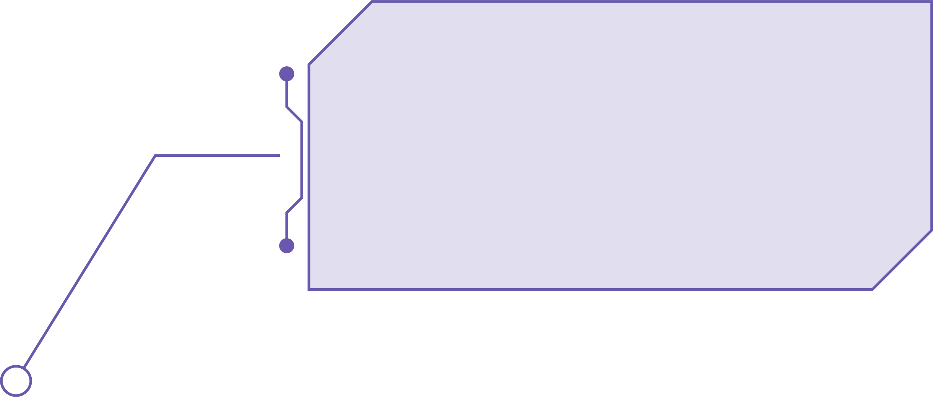
In today's digital age, web browsing has become an integral part of daily life. Browsers continuously track user activities and maintain logs of visited web pages.

Slide 6


Our goal
automatically categorize the website we visited
Enable advanced search and filtering options

Slide 7




Timeline
1. Idea & Planning
2. GUI Design
3. Core Functionality Implementation
4. Testing & Final Touches
.

Slide 8


Project Goals
Track Recently Visited Pages
Future Implementation
.
Add bookmark to Pages
DATA Security
Automatic Cleanup
User-Friendly Display

Slide 9
2
Our Process
Elaborate on what you want to discuss.

Slide 10

How it works?
1
How we store data
We create a node of double linked list for each URL
2
How we display
history
We display history using the display method in the double linked list.
3
Switching webpages
Switching between nodes helps to switch between webpages
4
Used stacks to implement Undo & Redo
Undo & redo

Slide 11

Your Project
Presentations are communication tools that can be used as demonstrations, lectures, speeches, reports, and more. It is mostly presented before an audience. It serves a variety of purposes, making presentations powerful tools for convincing and teaching.

Slide 12



Gallery Image
What can you say about your projects? Share it here!

Slide 13








Product Gallery
Elaborate on what you want to discuss.
1
2
Elaborate on what you want to discuss.
Elaborate on what you want to discuss.
3
4
Elaborate on what you want to discuss.
Elaborate on what you want to discuss.
Elaborate on what you want to discuss.
5
6

Slide 14

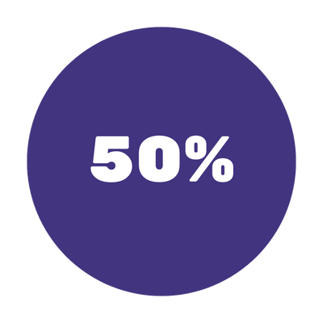
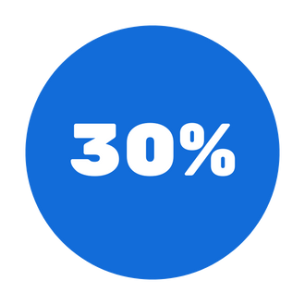
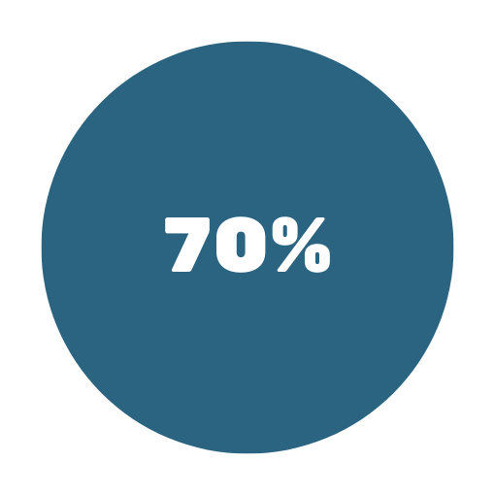

Add a Pricing Page
MONTHLY
MONTHLY
Add a feature
Add a feature
YEARLY
YEARLY
Add a feature
Add a feature

Slide 15
Simple Architecture
1. User Interface
2. Storage Layer
3.Clear History Easily
Displays the list of recently visited pages.
Save recent history data locally using simple databases
Allow users to clear all with a simple click using the provided button
Options to search, delete, clear all.
Browser’s Local Storage Indexed DB (for web apps).
Shows page title, URL

Slide 16

3
About Us
Elaborate on what you want to discuss.

Slide 17
Our History
Presentations are communication tools that can be used as demonstrations, lectures, speeches, reports, and more. It is mostly presented before an audience.

Slide 18
Expected Outcomes
A fully functional browser extension that captures and processes history data.
A dashboard application with categorized views, search, and filters.
Visual analytics reports showing browsing time, trends, and behavior patterns.
A privacy-first data storage system with encryption and access control.
Complete documentation, including user guide, developer notes, and testing results.

Slide 19
Challenges
Cross-Browser Compatibility:
Handling Large Datasets:
Privacy and Trust:
Ensuring the extension works uniformly across Chrome, Firefox, Edge, etc.
Performance issues may occur when dealing with large history logs
Convincing users that the system truly respects their privacy.

